Slide 1
Mobility Drive Test
Test Type : Mobility Test
Region : SEO
Area :美濃區
DT Completion Date (YYYY/MM/DD) : 2026/7/29
Total kilometers : 40.43 km

Slide 2
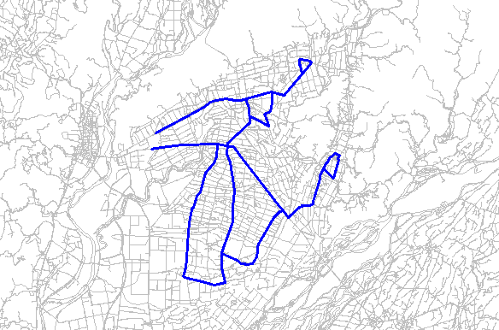
DT Route

Slide 3
DT Test Summary Result
Test Result |  | FET
5G Ratio (%) |  | 99.6%
NR PCI Count |  | 54
5G RSRP average (dBm) |  | -90.6
5G RSRQ average (dB) |  | -11.0
5G SINR average (dB) |  | 17.1
5G Modulation | QPSK (%) | 4%
 | 16QAM (%) | 10%
 | 64QAM (%) | 51%
 | 256QAM (%) | 34%
NR Rank |  | 2.3
5G SLOT Usage DL |  | 55.9
5G RB Num DL |  | 190.5
5G TX Power |  | 17.7
5G CQI WB DL |  | 9.5
5G MCS DL |  | 17.0
5G MAC DL TP (Mbps) |  | 258.6
ENDC Setup SR (%) |  | 100%
Test Result |  | FET (Lock 1800)
LTE PCI Count |  | 51
4G RSRP average (dBm) |  | -89.9
4G RSRQ average (dB) |  | -11.0
4G SINR average (dB) |  | 11.7
4G CQI WB DL |  | 9.3
LTE Carrier Num | 2CA (%) | 0%
 | 3CA (%) | 0%
 | 4CA (%) | 0%
 | 5CA (%) | 0%
4G Modulation average |  | 1.5
4G RB Num DL |  | 82.4
4G TX Power |  | 1.2
4G MAC DL TP (Mbps) |  | 41.1
App Throughput DL average (Mbps) |  | 308.1

Slide 4
NR NonCA & NR CA
Object1.0 |  | FET
 |  | Non-NR CA | NR CA
 |  | Pcell | Pcell | Scell
組合1 | Band | NR35 | NR35 | ESS 700
 | DL Thp | 254.9 | 241.4 | 17.5
 |  |  | 257.0
組合2 | % | 28.8% | 70.8%
組合2 | Band | ESS 700 (20M)
 | DL Thp | 0.0
 | % | 0.0%

Slide 5
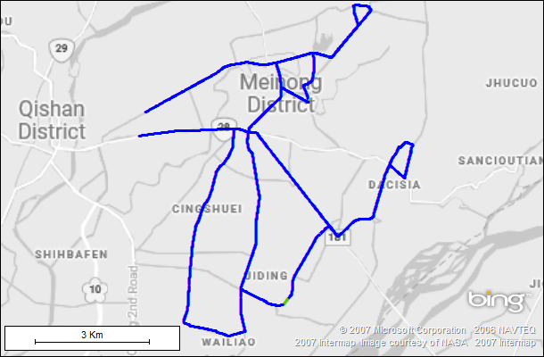
Technology Mode

Slide 6
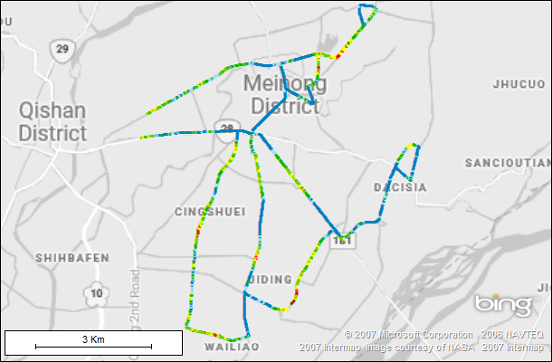
5G RSRP Comparison

Slide 7
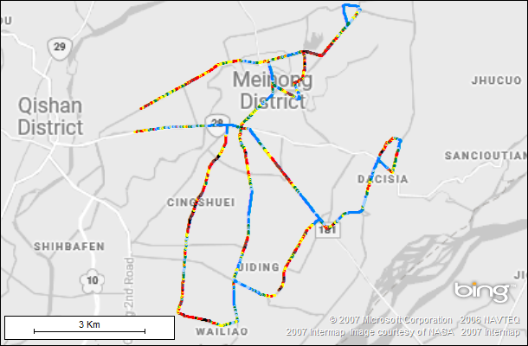
5G SINR Comparison

Slide 8
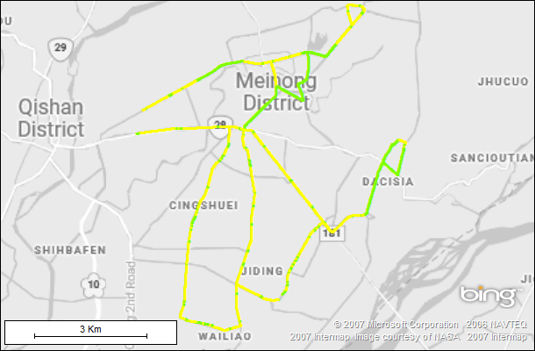
5G CA Configuration Ratio

Slide 9
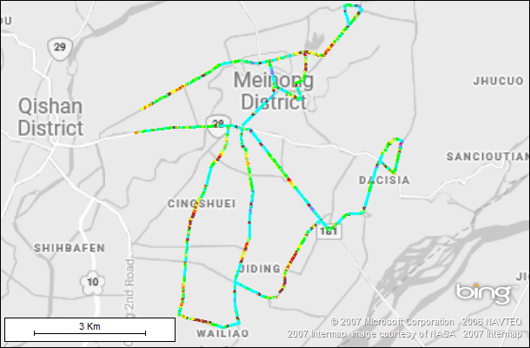
5G MAC DL Throughput Map

Slide 10
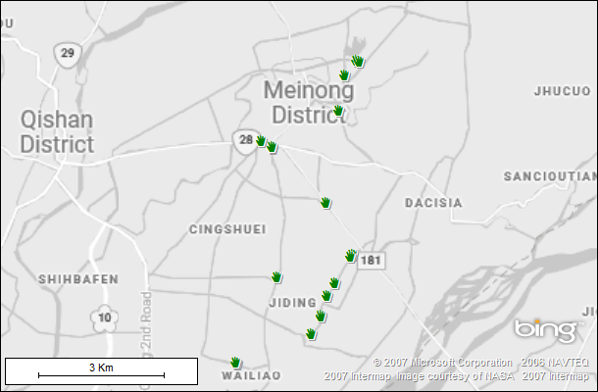
ENDC Setup and Fail

Slide 11
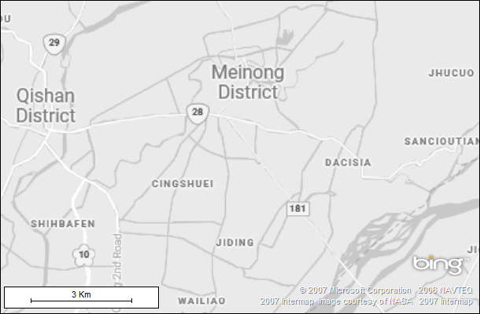
4G RSRP Comparison (L700/L900)
Lock 1800

Slide 12
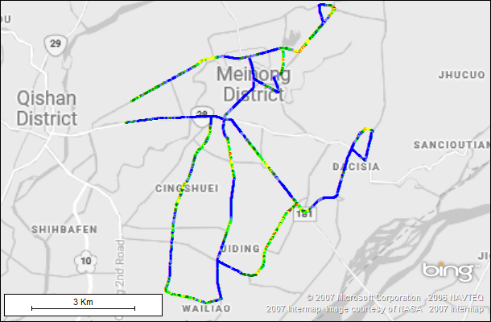
4G RSRP Comparison (L1800)

Slide 13
4G RSRP Comparison (L2100)
Lock 1800

Slide 14
4G RSRP Comparison (L2600)
Lock 1800

Slide 15
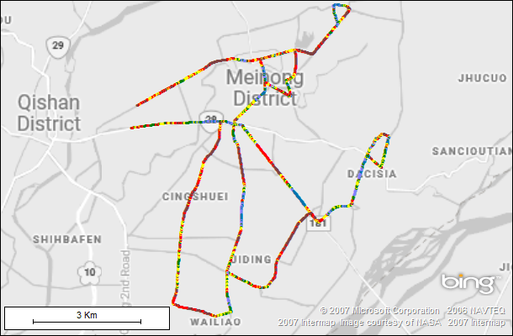
4G SINR Comparison

Slide 16
4G CA Configuration Ratio
Lock 1800

Slide 17
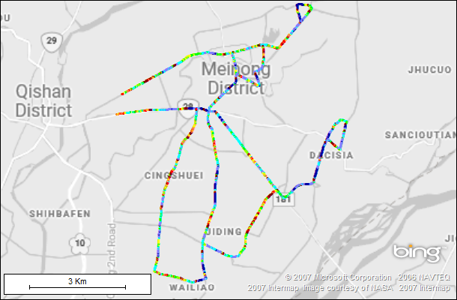
4G MAC DL Throughput Map

Slide 18
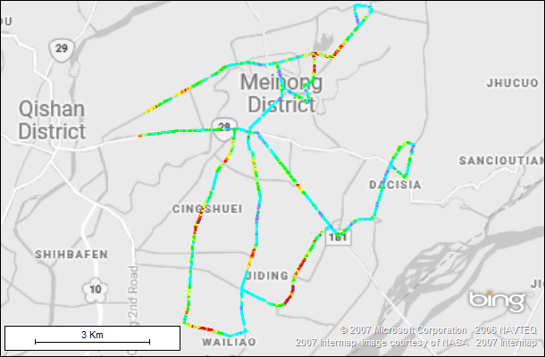
App DL Throughput Map

Slide 19
Problem Areas

Slide 20
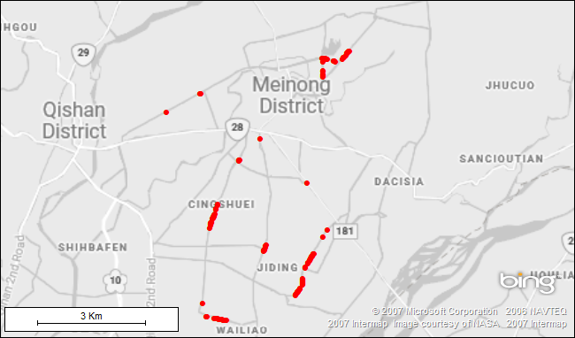
APP DL<50Mbps

